Slide 1
Classification Algorithm For Incomplete Dataset
Guided By: Submitted By :
Mrs. Rashmi Nikhil Dahiya (09010403112)
Hitesh Ahuja (09910403112)
Vikas (10010403112)
Rishabh Magoo (10310403112)

Slide 2
OBJECTIVE
To illustrate the potentials of dissimilarity based classification for missing values and to analyze the possible advantageous over procedure based on features.

Slide 3
Reasons for Incomplete Dataset
Delay or Failure in communication lines
Noise
Measurement Costs

Slide 4
Methods used Previously
Skipping Incomplete objects.
Imputation
Projection

Slide 5
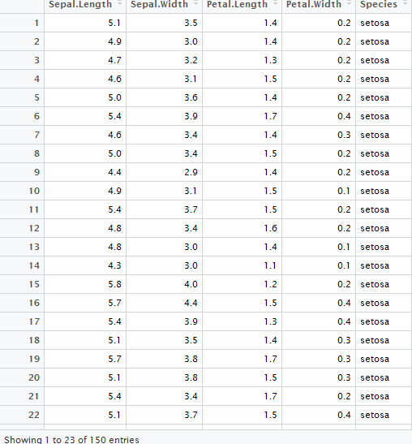
Datasets Used
Iris

Slide 6
Classifier Used
Naïve Bayes classifier (NBC)
Fisher Linear Discriminant
1-Nearest Neighbour Rule (1NN)

Slide 7
Naïve Bayes classifier (NBC)
Prior, conditional and joint probability for random variables
Prior probability:
Conditional probability:
Joint probability:
Relationship:

Slide 8
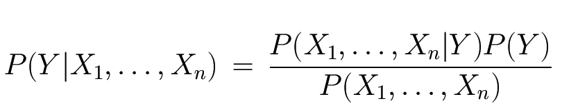
The Bayes Classifier
Problem statement:
Given features X₁,X₂,…,X_{n}
Predict a label Y
Use Bayes Rule!
Likelihood
Prior
Normalization Constant

Slide 9
Contd…
Prior :- probability that an event will reflect established beliefs about the event before the arrival of new evidence or information.
Likelihood :- The condition of being likely or probable probability.
Posterior :- The revised probability of an event occurring after taking into consideration new information.

Slide 10
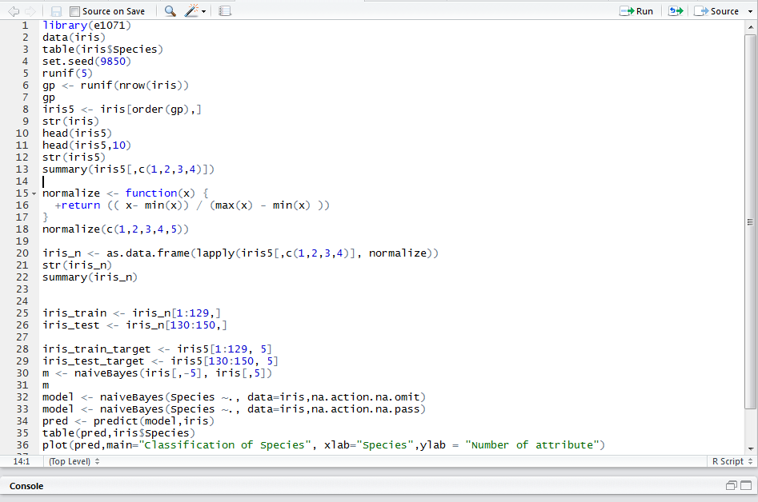
Implementation

Slide 11
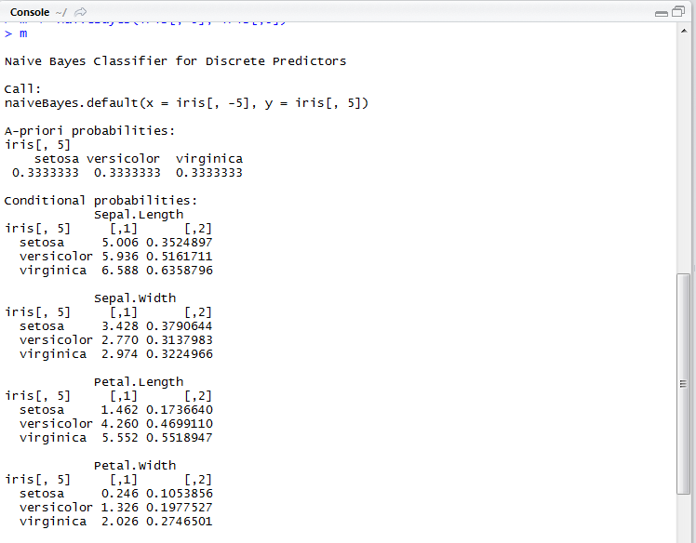
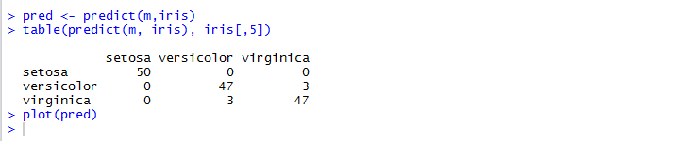
Probabilities

Slide 12
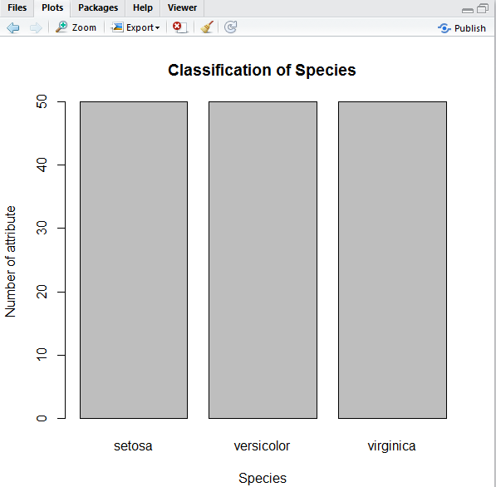
Iris Dataset(Attribute Species)

Slide 13
Fisher Linear Discriminant
Modeling difference in groups(Multivariate Analysis).
Separating two or more classes, objects and categories.
Similar to Probit models

Slide 14
Contd…
It creates an equation which will minimize the possibility of misclassifying cases into their respective groups or categories. It involves a linear equation in the following form: D=a1*X1+a2*X2+………ai*Xi Where D=discriminant function Xi=No. of discriminant variables a=Discriminant Coefficients

Slide 15
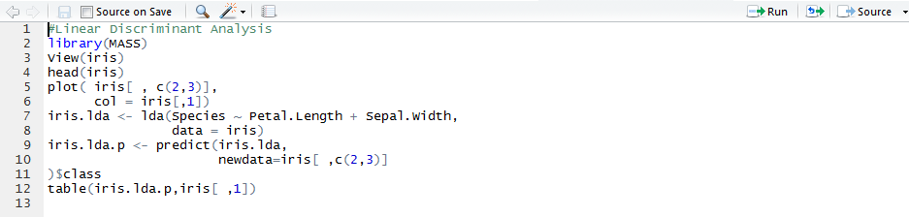
Implementation

Slide 16
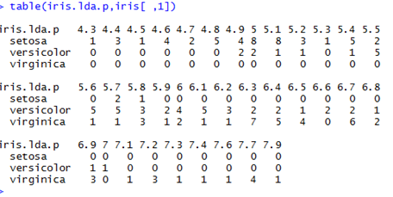
Output

Slide 17
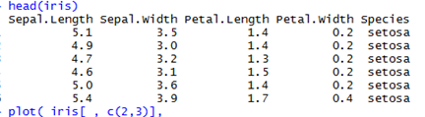
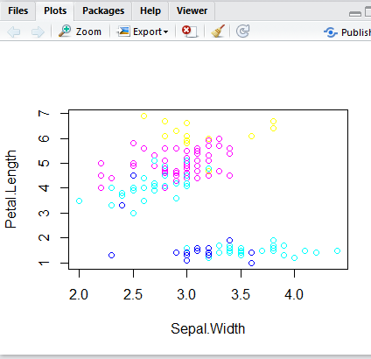
Output Plot :

Slide 18
K-Nearest Neighbour Classification
For each row of the test set, the k nearest (in Euclidean distance) training set vectors are found.
The classification is decided by majority vote, with ties broken at random.
If there are ties for the kth nearest vector, all candidates are included in the vote.

Slide 19
KNN - USAGE
knn(train, test, cl, k = 1, l = 0, prob = FALSE, use.all = TRUE)
Arguments :
Train : matrix or data frame of training set cases.
Test : matrix or data frame of test set cases.
Cl : factor of true classifications of training set.
K : number of neighbours considered.
L : minimum vote for definite decision, otherwise doubt. (More precisely, less than k-l dissenting votes are allowed, even if k is increased by ties.)

Slide 20
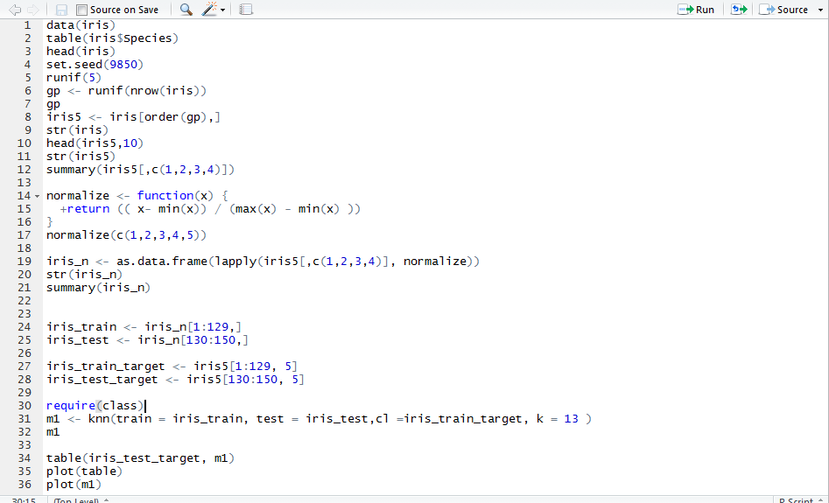
Implementation

Slide 21
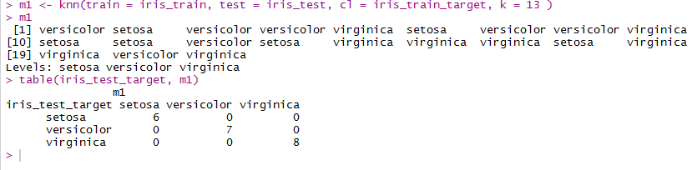
KNN output for Iris Dataset

Slide 22
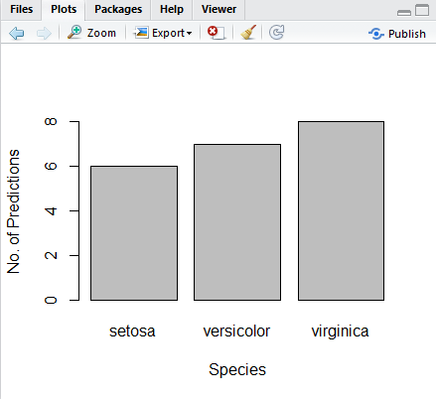
Output Plot:

Slide 23
References
M. Millan-Giraldo,Robert P.W.Duin and J.S. Sanchez ,“Dissimilarity-based Classification of Data with Missing Attributes”,in 2nd International Workshop on Cognitive Information Processing , pp. 293-298, 2010.
S.Zhang,”Parimputation: from imputation and null-imputation to partially imputation”, in IEEE Intelligent Informatics Bulletin, vol. 9,pp. 32-38, 2008.
Bruzzone, L. Poli, R. Serpico,”S.B.: An extension of Jeffereys Matusita distance to multiclass cases for feature selection”, in IEEE Transaction on Geoscience and Remote Sensing,vol. 33(6),pp. 13-18, 1995.
T.Delavallade and T.H. Dang,”Using Entropy to Impute Missing Data in a Classification Task”,in IEEE International Conference in Fuzzy Systems, pp. 1-6, 2007.

